Slide 1
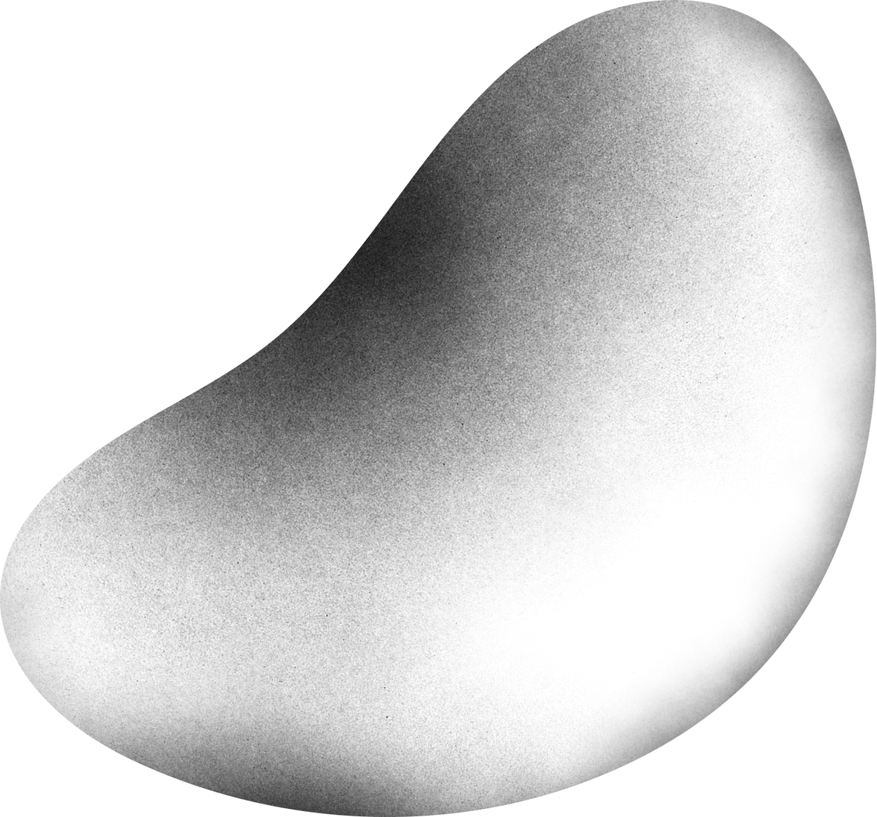

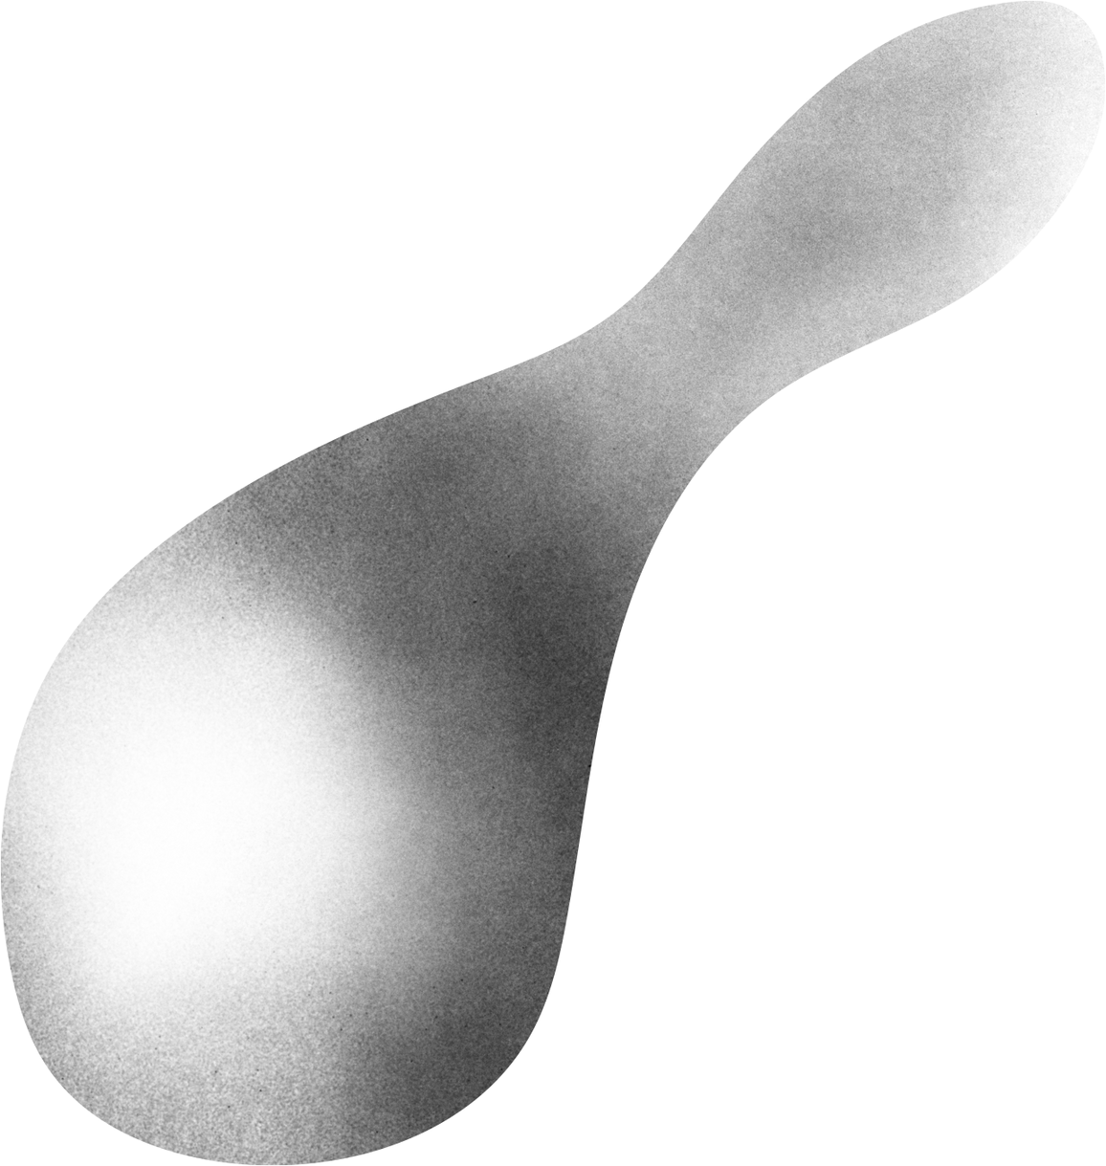
CAR INSURANCE FRAUD DETECTIONS
Presented by Feras Alyahya ,Ahmed Alonaizi ,Hussain Alhadab and Mohammed Alhamoud

Slide 2
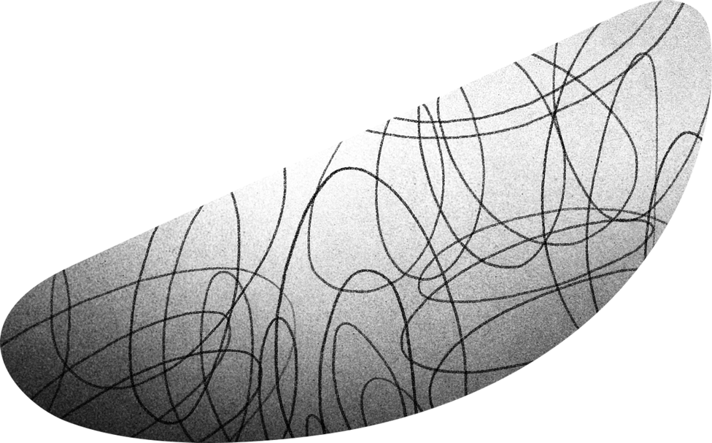
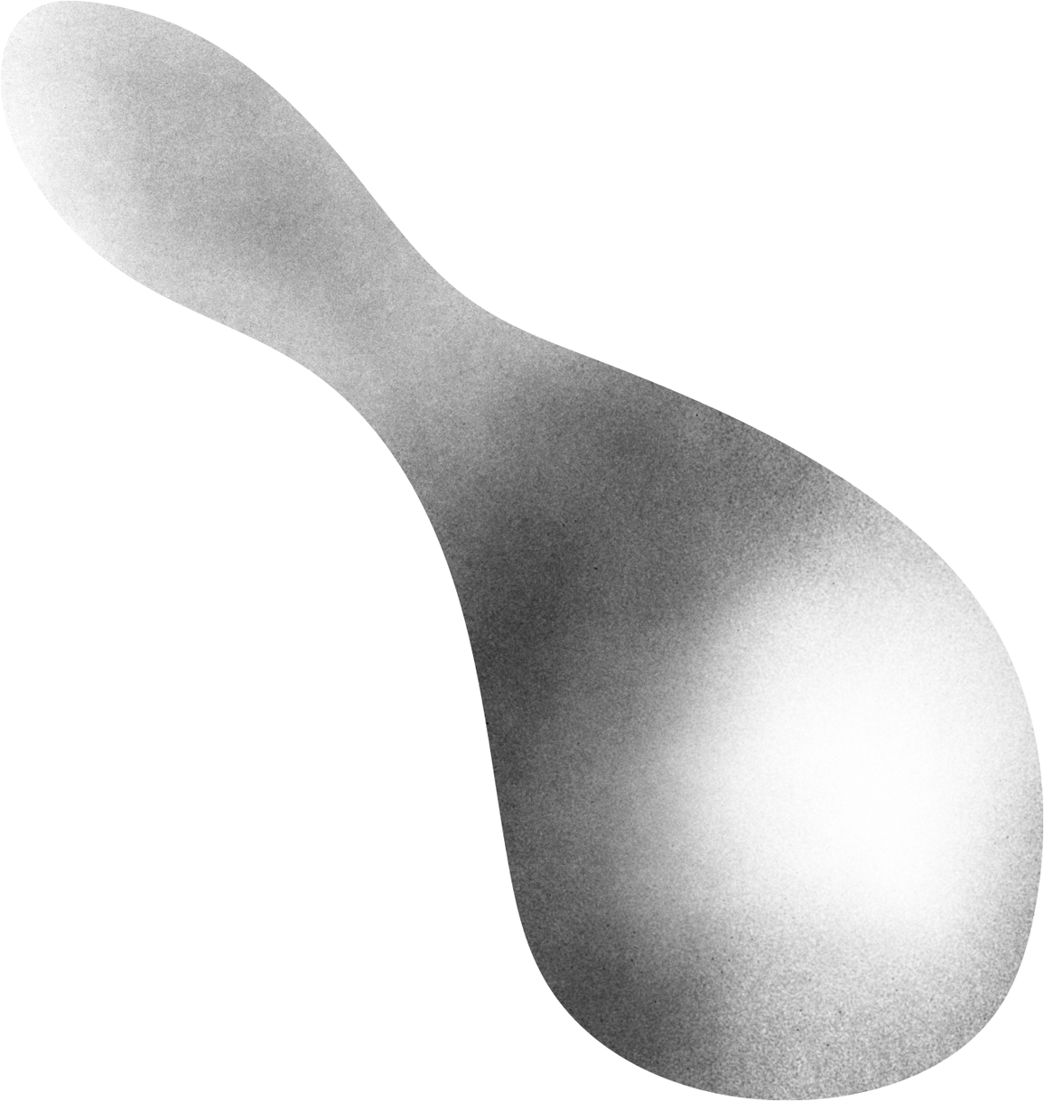
OUTLINE
01
02
03
04
05
introduction
Data
Result
Best model
Conclusion

Slide 3
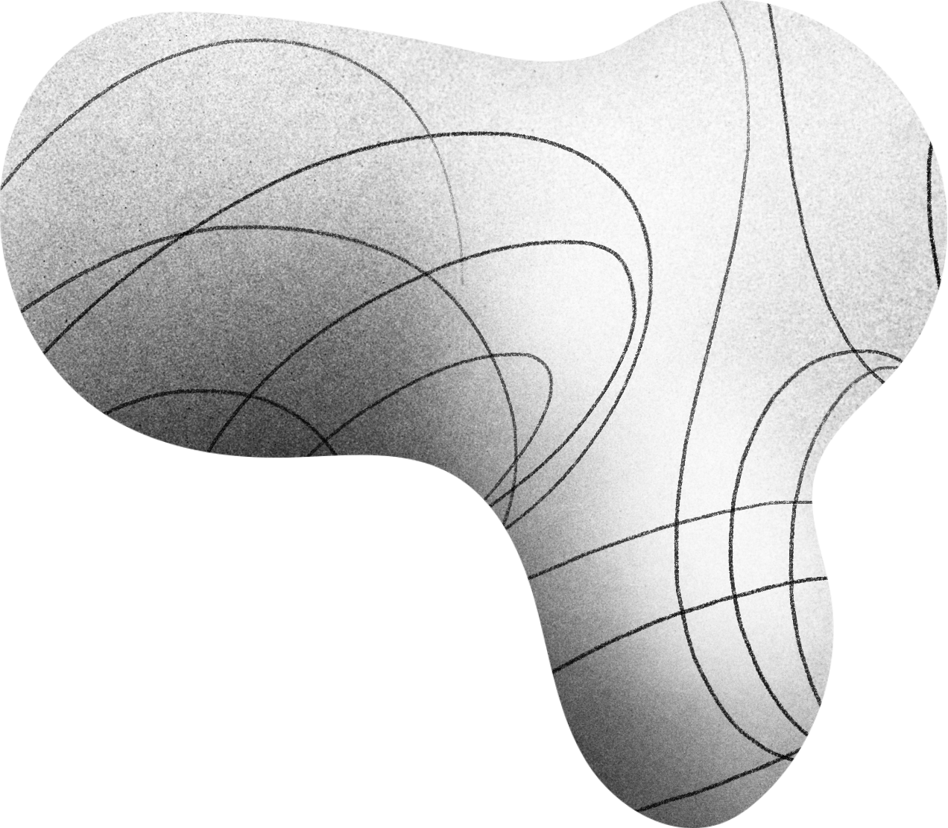
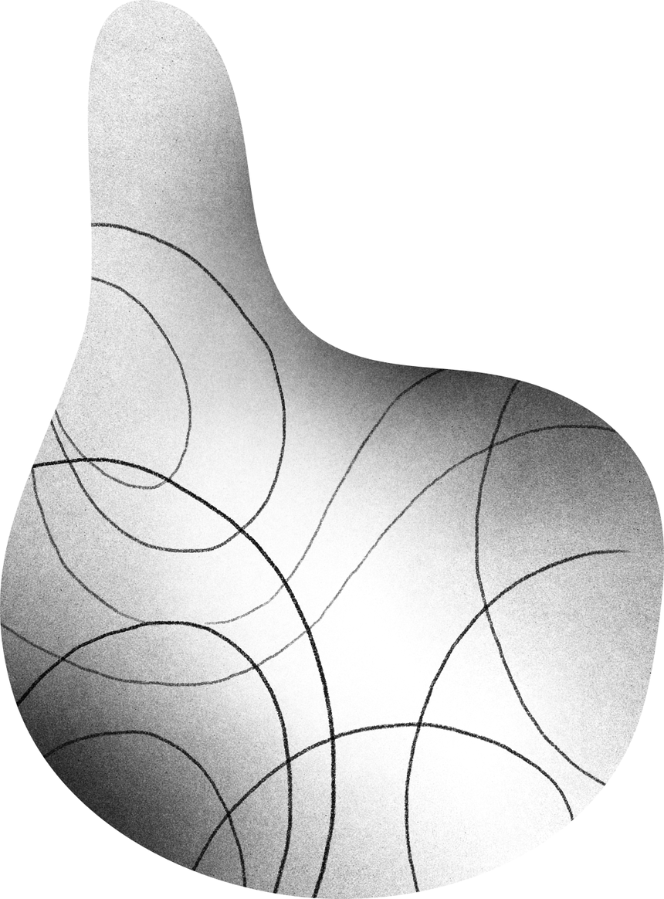
INTRODUCTION

Slide 4
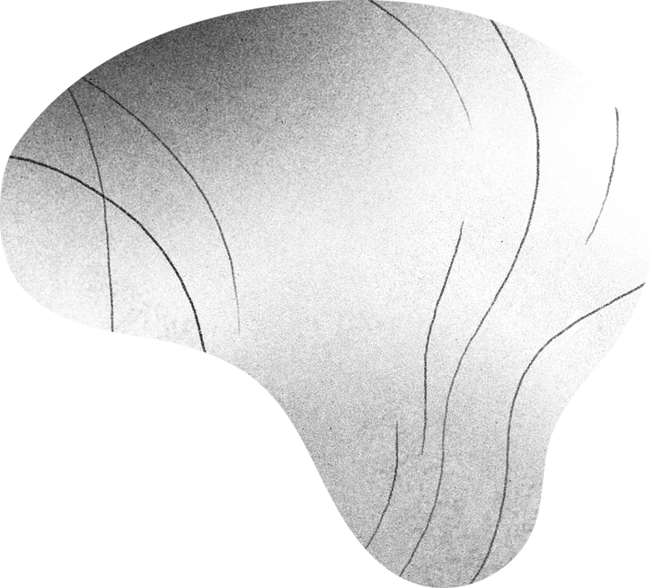
PROPLEM :
With the large number of traffic accidents insurance companies receive claims for financial compensation to the beneficiaries, and with the many claims appear multiple fraud cases and undeserved financial claims, so insurance companies face difficulty in identifying and detecting fraud in car accidents, insurance companies need a solution to help them detect fraud and identify the factors and causes of fraud, based on all factors related to the accident .
SOLUTION :
IN THIS PROJECT, WE ARE GOING TO DEVELOP A CLASSIFICATION MODEL TO DETECT FRAUD.

Slide 5
DATA

Slide 6
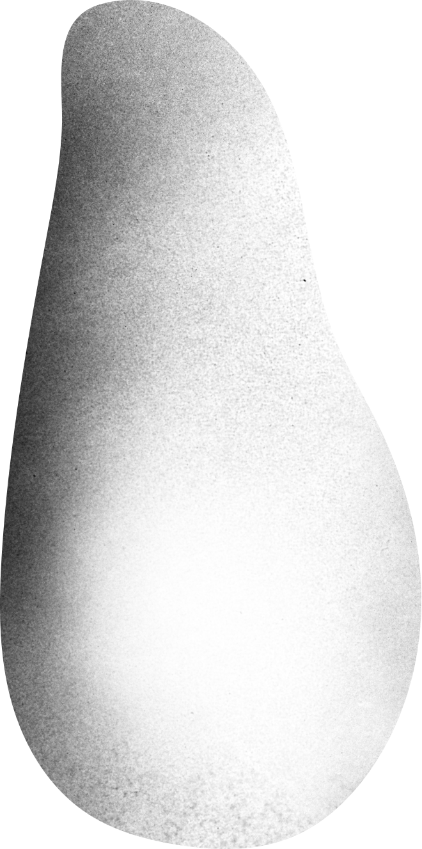
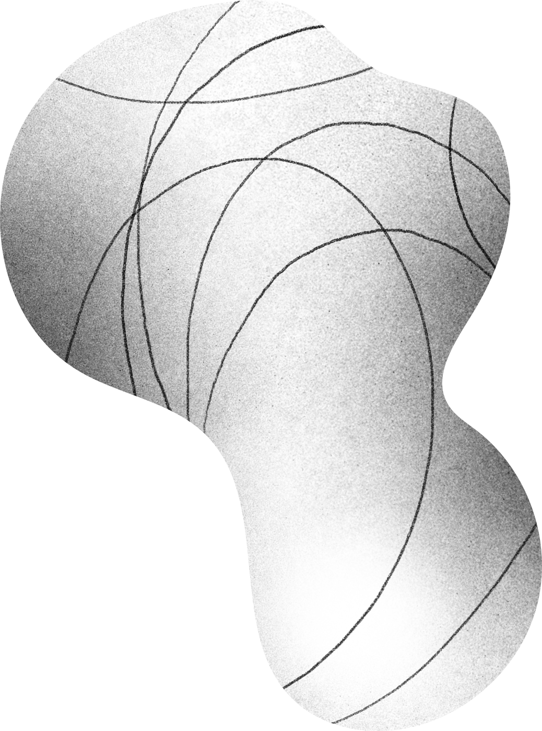
DATA DESCRIPTION
Dataset contains 34 columns and more than 11000 record
Sex | MaritalStatus | Age | Fault | PolicyType | VehicleCategory | VehiclePrice | RepNumber | Deductible | DriverRating | Days_Policy_Accident | Days_Policy_Claim | PastNumberOfClaims | AgeOfVehicle | AgeOfPolicyHolder | PoliceReportFiled | WitnessPresent | AgentType | NumberOfSuppliments | AddressChange_Claim | NumberOfCars | BasePolicy | ClaimSize.

Slide 7
RESULT

Slide 8


Result
test
F1
AUC
Log-Loss
Logistic Regression
using all features
0.000
0.717
0.208
using some of the features
0.000
0.502
0.228
using some of the features with dimensionality reduction
0.028
0.782
0.195
using some of the features with Over-sampling using SMOTE
0.924
0.975
0.203
Random Forest
using some of the features
0.122
0.799
0.253
using some of the features with Over-sampling using SMOTE
0.967
0.993
0.120
using some of the features with RandomizedSearchCV & Over-sampling using SMOTE
0.964
0.992
0.152

Slide 9
Result
test
F1
AUC
Log-Loss
using some of the features
0.000
0.540
1.276
KNN
After resampling & GridSearchCV
0.203
0.924
0.975
xgboost
some of the features with Over-sampling using SMOTE
0.969
0.992
0.106
Support Vector Machine
Some of the features with Over-sampling using SMOTE
0.984
0.996
0.053

Slide 10
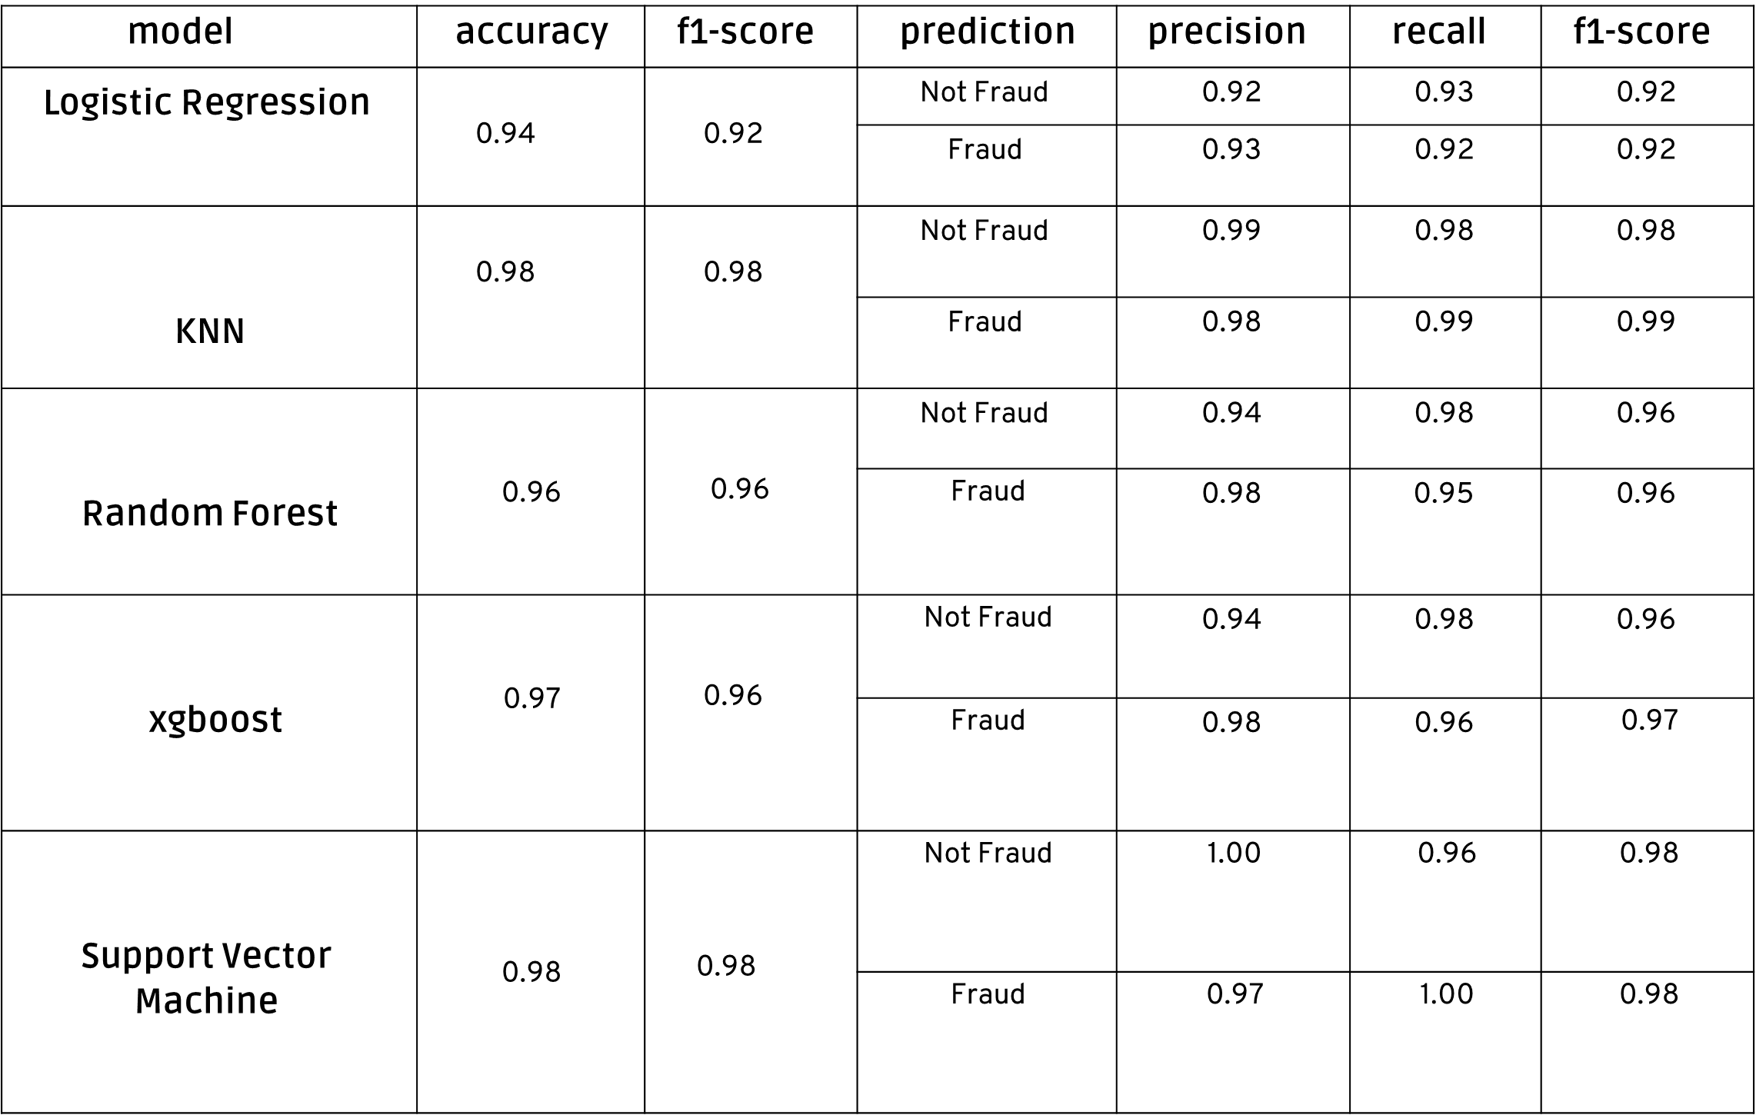
Result

Slide 11
BEST MODEL

Slide 12
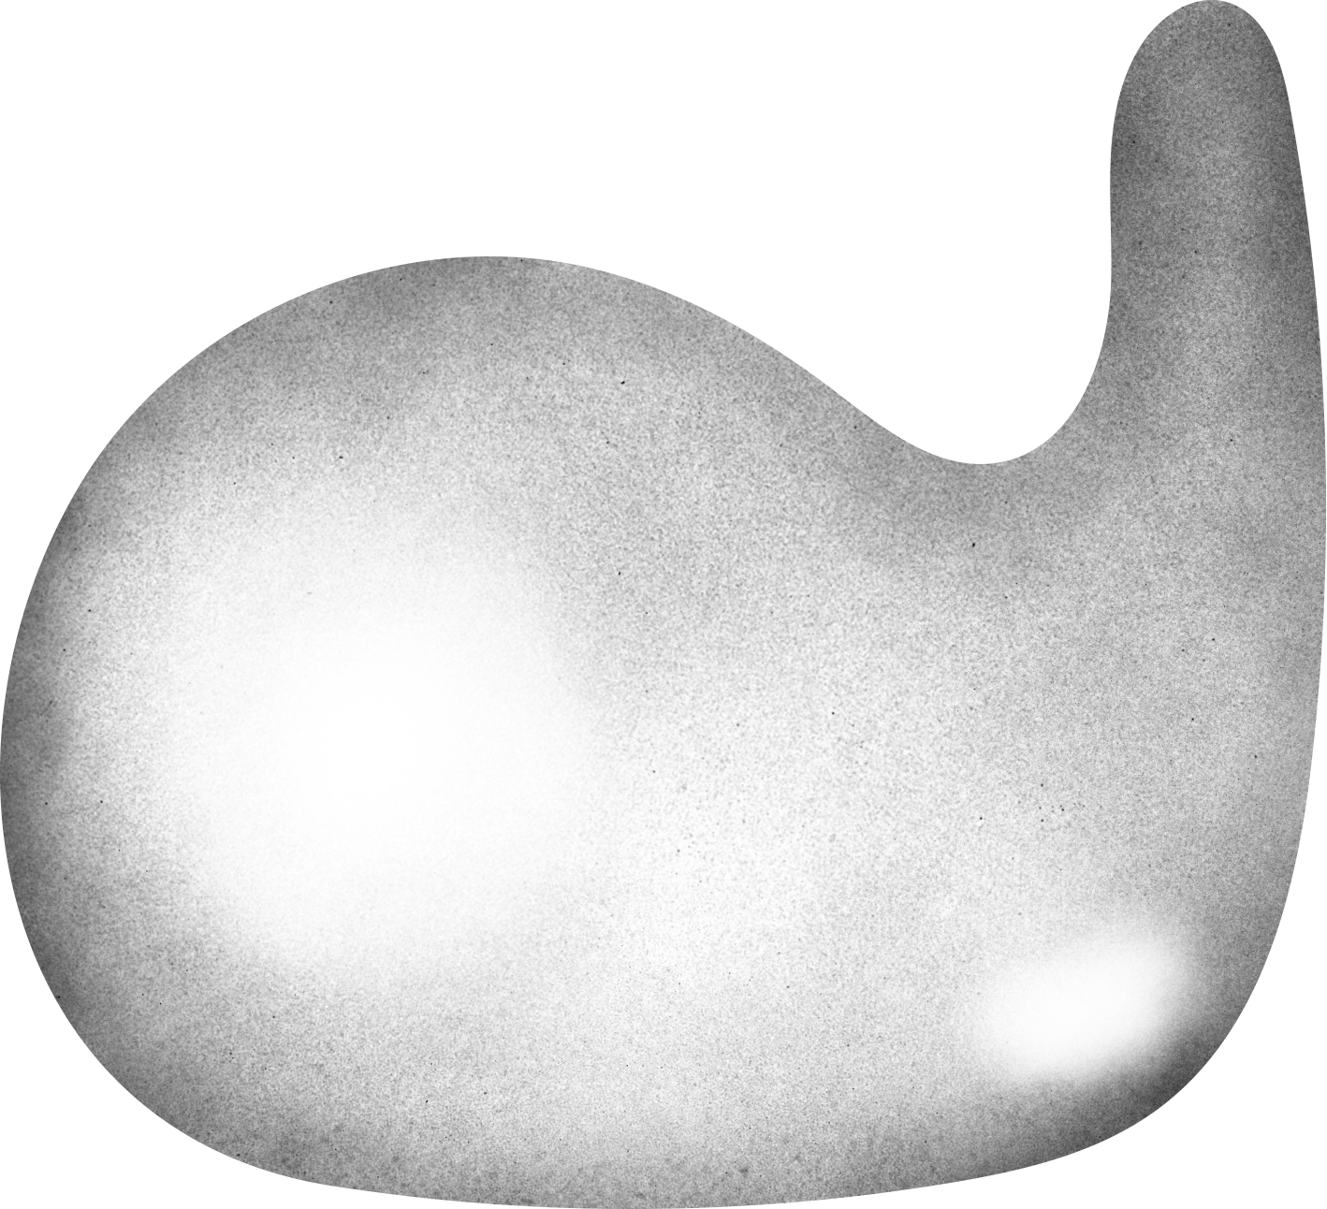
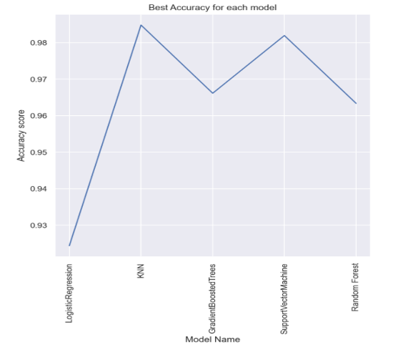
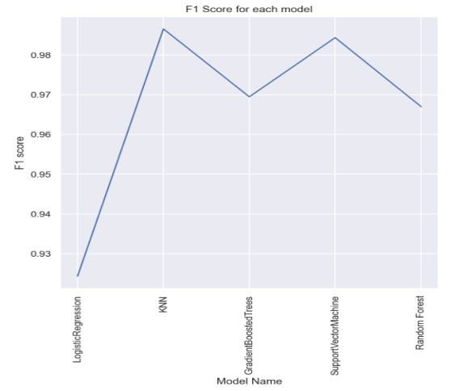
BEST MODLE
KNN
test
F1
AUC
Log-Loss
After resampling & GridSearchCV
0.987
0.984
0.525

Slide 13
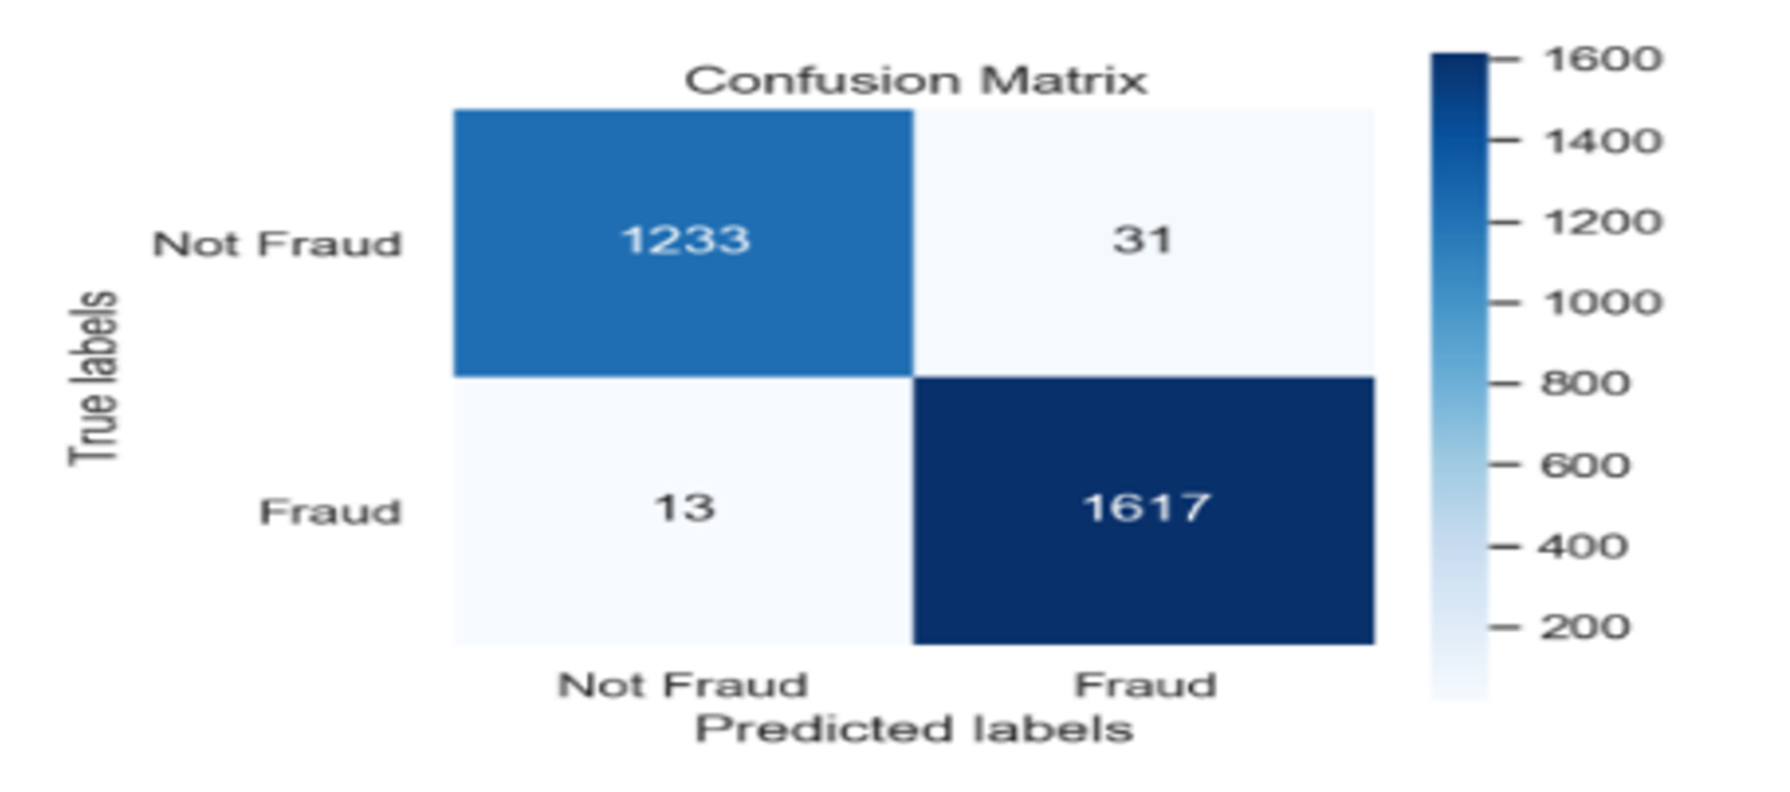
BEST MODLE
KNN
test
F1
AUC
Log-Loss
After resampling & GridSearchCV
0.987
0.984
0.525

Slide 14
CONCLUSION
We made 5 models, We came up with the best model to do fraud detection After receiving the characteristics for each claim, the model will help insurance companies to help them detect fraud clime. We achieved very good accuracy 98% In the best model

Slide 15
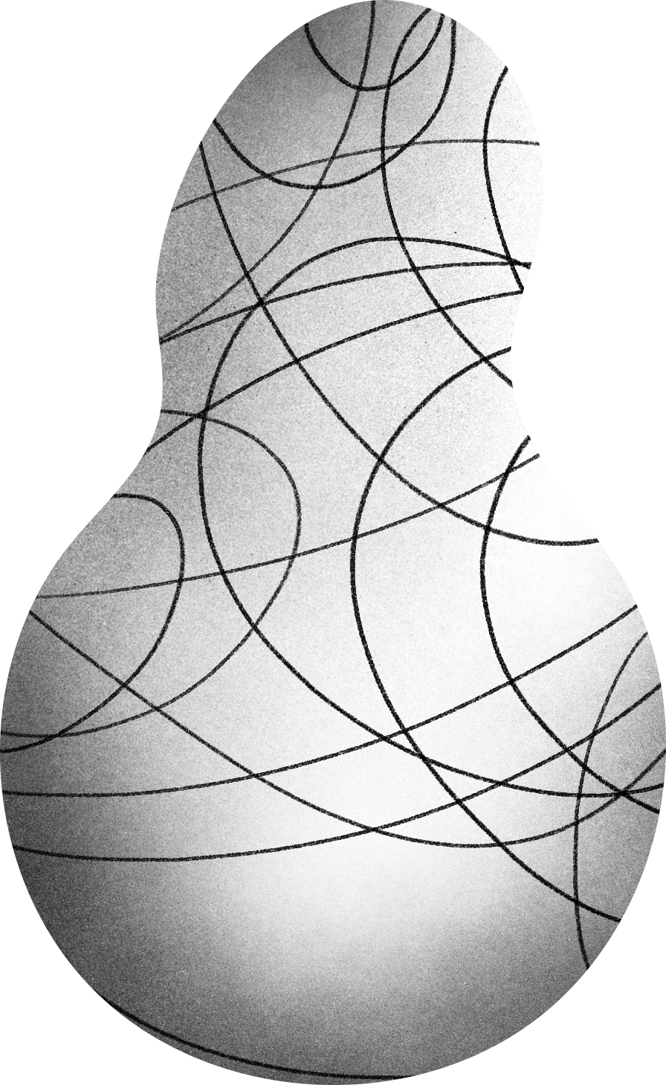
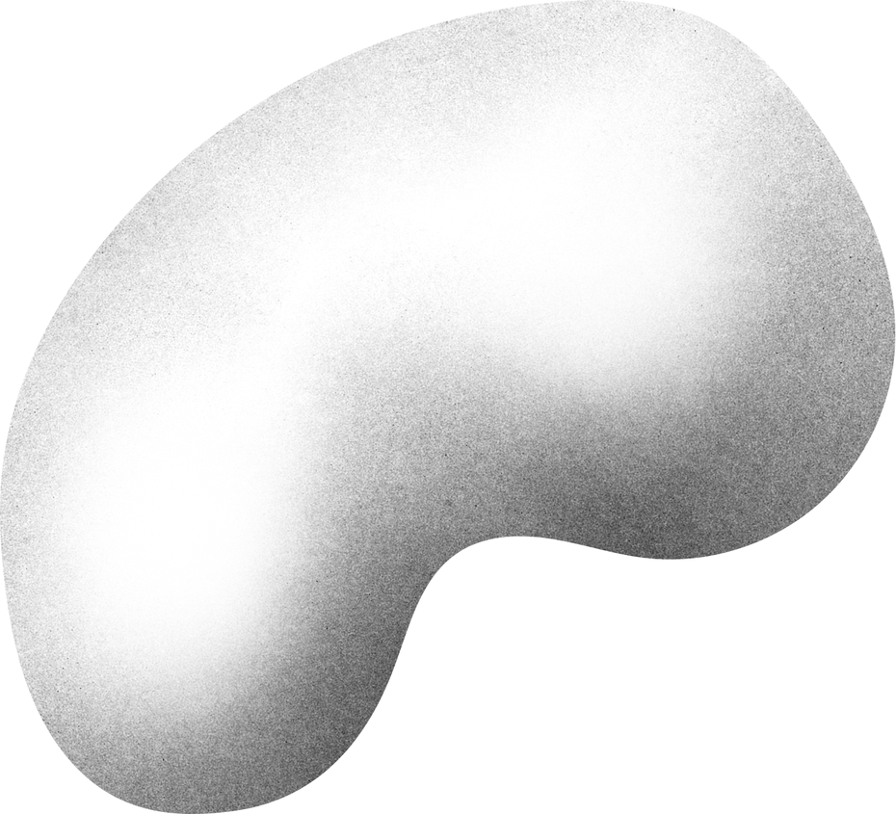
THANK YOU!

